Slide 1



JAVA PROJECT NOTEPAD

Slide 2
PROGRAMMING IN JAVA
DATE 24/06/2023
SUBMITTED TO: DR. SACHIN BALKRISHNA JADHAV
SUBMITTED BY :
KOMAL KUMARI(22/10/JC/002)
MAHIMA(22/10/JC/038)
SCHOOL OF COMPUTER AND SYSTEMS SCIENCES
NOTEPAD

Slide 3
OBJECTIVE
Create a functional text editor application that allows users to create, edit, save, and print text files with a user-friendly interface.

Slide 4
Concepts used
We have developed this project using:
1.File handling
2.Swing

Slide 5
Algoritham of this code
Start
Create a new Notepad object.
Invoke the createAndShowGUI method on the Notepad object to display the GUI.
Initialize the GUI components, such as the JFrame, JMenuBar, JTextArea, and JMenuItems.
Add action listeners to the menu items and set their accelerators.
Handle the actionPerformed method:
6.1. If the action command is "New", clear the text area
6.2. If the action command is "Open", show a file chooser dialog and read the selected file's contents into the
text area.
3. If the action command is "Save", show a file chooser dialog and write the text area's contents to the
selected file.
6.4. If the action command is "Exit", exit the application.
5 If the action command is "Cut", cut the selected text in the text area.
6.6. If the action command is "Copy", copy the selected text in the text area.
7 If the action command is "Paste", paste the copied/cut text into the text area.
6.8. If the action command is "Select All", select all the text in the text area.
9 If the action command is "About", show a dialog box with an "About" message.
10.END

Slide 6
Essential for reading and writing text files.
Basic implementation of File handling using Java swing application
printing: : content of JTextArea sent to default printer using print() method.
Opening file:file chooser dialogue is dispayed .Read using BufferedReader and contents dispayed in JTextArea component.
Saving file: JFileChooser displayed
Text from JTextArea ,written using BufferedWriter

Slide 7
Inbuilt package in java
swing
Used : to create GUI
To use:
Need to import Javax.swing package
Provides components:
menus, progress bar, trees, dialogue box etc.
Offers:
Classes ,interfaces , methods

Slide 8
Container: Area where any graphical components are embedded
Container are specially used in case of applet programs
Javax.swing package offers :
1.JFrame class: used to offer an independent window to add components to it.
2.JPanel class: allows to add any number of components but does not have its own window.

Slide 9
Need to use getcontentpane() to object of this class
Container class
Abstract class:
So can not be instantiated
Builtin class of javax.swing package
Allows to create a window

Slide 10
Packages used in this project
- `import javax.swing.*;`: Imports the necessary classes from the `javax.swing` package, which provides GUI components and functionality.
- `import javax.swing.filechooser.FileNameExtensionFilter;`: Imports the `FileNameExtensionFilter` class from the `javax.swing.filechooser` package, used to filter file selections in a file chooser dialog.
- `import java.awt.*;`: Imports the necessary classes from the `java.awt` package, which provides core classes and interfaces for creating graphical user interfaces.
- `import java.awt.event.ActionEvent;`: Imports the `ActionEvent` class from the `java.awt.event` package, representing an action event that can be triggered by user actions.
- `import java.awt.event.ActionListener;`: Imports the `ActionListener` interface from the `java.awt.event` package, used to handle action events.
- `import java.awt.event.KeyEvent;`: Imports the `KeyEvent` class from the `java.awt.event` package, representing a key event that can be triggered by keyboard input.

Slide 11
- `import java.awt.print.PrinterException;`: Imports the `PrinterException` class from the `java.awt.print` package, used to handle exceptions related to printing operations.
- `import java.io.BufferedReader;`: Imports the `BufferedReader` class from the `java.io` package, used for reading text from character input streams efficiently.
- `import java.io.BufferedWriter;`: Imports the `BufferedWriter` class from the `java.io` package, used for writing text to character output streams efficiently.
- `import java.io.FileReader;`: Imports the `FileReader` class from the `java.io` package, used for reading character files.
- `import java.io.FileWriter;`: Imports the `FileWriter` class from the `java.io` package, used for writing character files.
- `import java.io.IOException;`: Imports the `IOException` class from the `java.io` package, used to handle input/output exceptions.
These import statements allow the usage of classes and exceptions related to printing, file reading, and writing operations in the Java code.

Slide 12
FEATURE IMPLEMENTED IN THIS CODE
Menu Bar: The application includes a menu bar at the top of the window, which contains three menus: "File," "Edit," and "Help."
File Operations: The "File" menu includes options for file operations such as creating a new file, opening an existing file, saving the current file, printing the file, and exiting the application.
Text Editing Operations: The "Edit" menu includes options for text editing operations such as cutting selected text, copying selected text, pasting text from the clipboard, and selecting all text in the text area.
About Dialog: The "Help" menu includes an "About" option, which displays a dialog box with information about the application.
Keyboard Shortcuts: The application assigns keyboard shortcuts (accelerators) to various menu items, allowing users to perform actions using keyboard combinations.
Text Area: The main area of the application is a JTextArea component where users can enter, edit, and view text. The text area supports line wrapping and scrolling when the content exceeds the visible area.

Slide 13
ACTION LISTENER INTERFACE
ActionListener: The code implements the ActionListener interface to handle action events generated by menu items.
JFrame: The code creates an instance of JFrame to represent the main window of the application.
JMenuBar: The code creates a JMenuBar and adds it to the JFrame to display the menu bar at the top of the window.
JMenu and JMenuItem: The code creates JMenu and JMenuItem objects to define menus and menu items within the menu bar.
JTextArea: The code creates a JTextArea component to display and edit text content within the main window

Slide 14
NOTEPAD CONSTRUCTOR
Sets up JFrame (window) for the Notepad application and configures its properties.
sets up the menu bar and adds menus and menu items to it.
includes various configurations and event listeners for the components used in the Notepad application.
These configurations and event listeners ensure that the appropriate actions are performed when the user interacts with the menu items and buttons, providing functionality to the Notepad application.
JScrollPane: The code wraps the JTextArea with a JScrollPane to provide scrolling functionality when the text content exceeds the visible area.

Slide 15
Overriding
Event Handling: The actionPerformed() method is implemented to handle specific actions based on the user's selection from the menus.
JFileChooser: The code uses a JFileChooser dialog to allow users to select files for opening and saving.
File I/O: The code uses BufferedReader and BufferedWriter classes to read from and write to text files.

Slide 16
Contribution of this code
MAHIMA- IMPLEMENTED OVERRIDING USING ACTION PRODUCED METHOD
KOMAL-IMPLEMENTED JFRAME FOR WINDOW APPLICATION
GUI –IMPLEMENTED TOGETHER AFTER UNERSTANDING FROM VARIOUS SOURCES.
PRESENTATION : MADE BY BOTH OF US TOGETHER

Slide 17
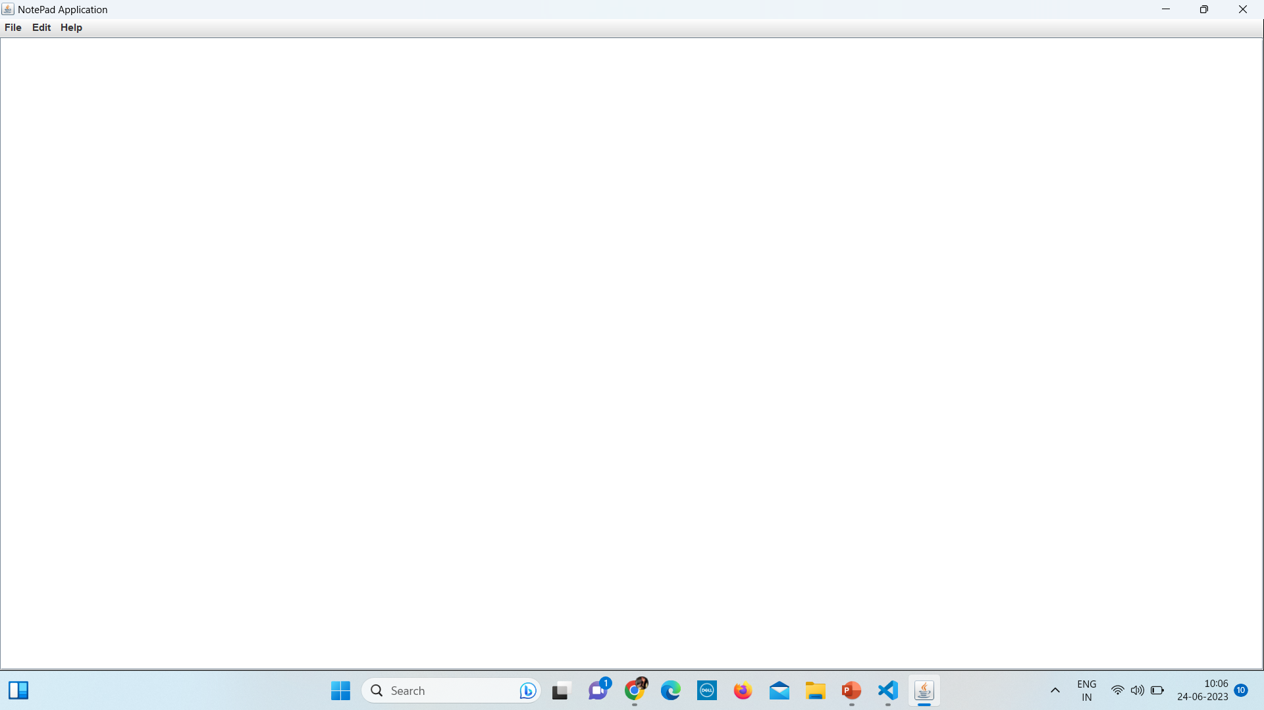
Output

Slide 18
THANK YOU
.

